Slide 1


DripCards
DripCards
COM-430 Software Engineering Project
Naomi Nash & Daria Pacheco
Notes:
Dr. Adam’s D2L Announcement: “Make this an elevator pitch. This is only a summary of your entire experience, your build, what your goals where and to what milestone you made it to in your overall project.”

Slide 2
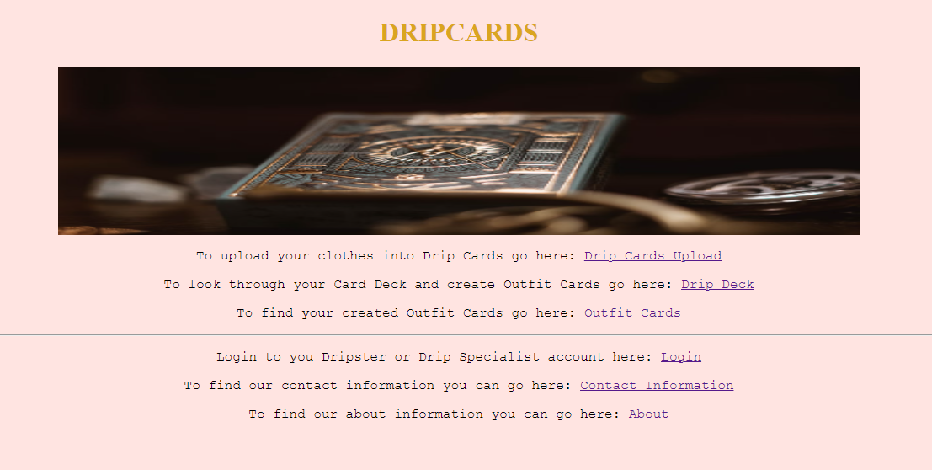


DripCards – What is it?
DripCards is a web application developed by Naomi Nash and Daria Pacheco that allows users to plan their outfits for the week without touching their closets. It also offers plenty of wonderful features that allow users to find clothes they don’t wear as often anymore to sell or donate, communicate and interact with other users interested in the world of fashion, and find clothing items on other user’s Outfit Cards that are calling their name!
DripCards
Home Page

Slide 3
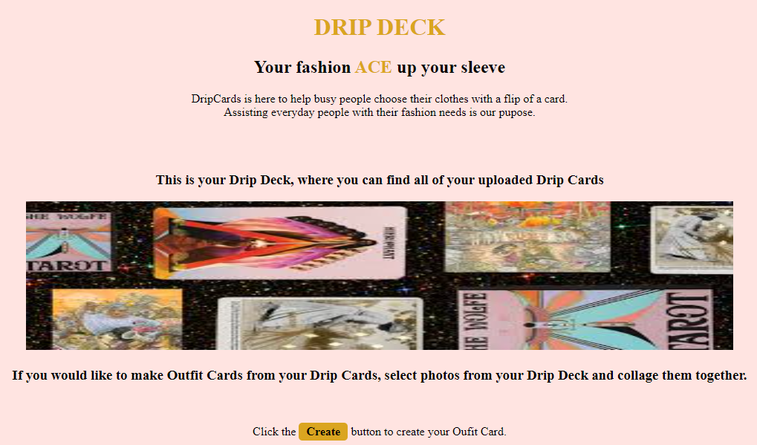
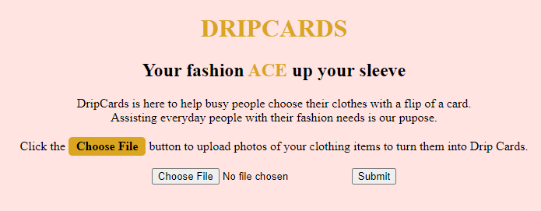
The Build
DripCards is a web-based application coded in HTML
It is a multi-paged site with pages pertaining to the home page, an upload page for photos of clothing items in the user’s closet, a page to view the user’s Drip Deck as well as make new Outfit Cards, a page to view/delete previously created Outfit Cards, a login page, a page listing the contact information of the developers (Naomi and Daria), and a final page explaining the purpose of DripCards as well as the creators behind it.
DripCards
Drip Cards Upload Page
Drip Deck and Outfit Creation Page

Slide 4
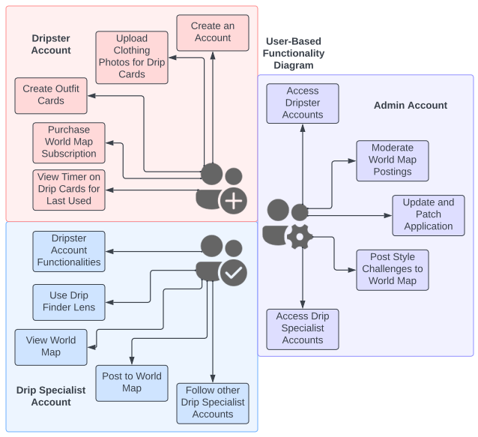
Feature Highlights
By uploading their clothing pieces into the web applications, the newly created Drip Cards can be combined by the user, either purposefully or randomly, into Outfit Cards as they plan their outfits for the day, week, or any occasion.
Users can revisit their “online closet” by looking into their Drip Deck, a display of their Drip Cards with a timer on each that allows the user to know when the last time they used that item for an Outfit Card was.
*A splendid way to clean out your closet of all the clothes you don’t wear anymore!
After paying a subscription fee and going from a Dripster to Drip Specialist status, users can explore the World Map which offers many wonderful chances to learn about current fashion trends and where to find that shirt or pant on an Outfit Card that’s calling your name!
User’s have the ability to follow Drip Specialists they like as well as comment on other Drip Specialist’s posts
User’s can use the Drip Finder tool to view clothing items they like from a specific Outfit Card and find an online store where they can purchase it for themselves
User-Based Functionalities
DripCards

Slide 5
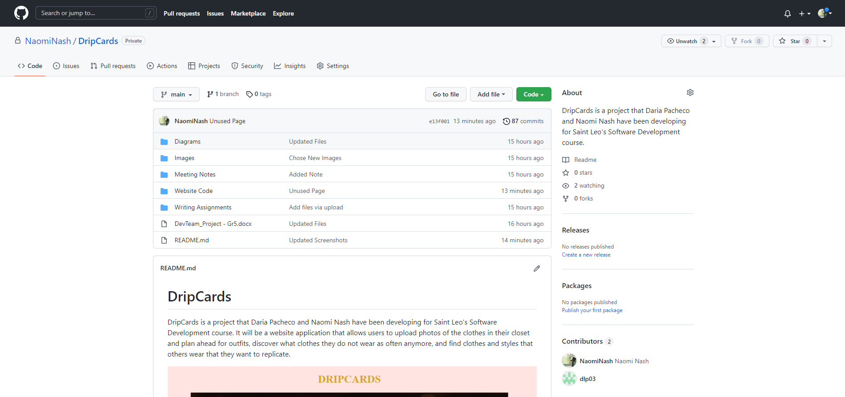
Project Progression Check Point
DripCards is currently at the stage where it has the beginnings of intricate webpages for the site as well as detailed plans for the progression of the application for the future.
A fully complete report has also been created for DripCards that outlines the entire application including, but not limited to, the software, the architecture, the users that will be utilizing the application, all notes from meetings as well as documented points of progress, and initial features and scenarios as well.
A GitHub repository dedicated only to the DripCards web application has also been created to allow for online organization of all materials related to the project including its code, diagrams, images, and completed report.
DripCards
DripCards GitHub Page

Slide 6

DripCards – The Goals for the Semester
We wanted to learn the DevOps development process so that we could implement it ourselves with our own software engineering project
To best develop the project, we looked into learning how to utilize applications such as Azure DevOps and GitHub so that we could properly develop our project with software applications we would find in the field if we were to ever look into software engineering as a career
We strived for the DripCards web application to be a multi-paged website with a dedicated idea of what the page layouts would be for future development
One big thing we looked for was to have access to a fully organized GitHub to have a shared, organized space to hold all files dedicated to the DripCards web application project
To help have all our ideas and plans organized, we wanted to ensure that we had a fully itemized report that displayed important development information such as user stories, features, and scenarios as well as diagrams illustrating the software, architecture, database, testing, and so much more.
DripCards

Slide 7

DripCards – The Goals for the Future
Our first goal is to continue to develop the code for the DripCards web application with CSS and JavaScript additions
Following this, we would love to make the features we planned out for the application, the uploading of clothing item photos, the creation of outfit cards, the World Map subscription and social aspect, and the Drip Finder (Cloud Vision API) fully functional
After we have the core of our application developed, we want to develop a personalized logo for the application that can be easily used for the web front, promotional ventures, and more
DripCards

Slide 8

The Experience of Creating DripCards & Our Next Step
Our overall experience has been incredibly mixed, but with a more so positive view in the end. The development process has been chaotic and hectic and stressful at times, and we have gone back and forth on working out how to complete different tasks. However, there have also been many positive moments. We have created an application that we are deeply proud of. Throughout the process that has had moments where we never thought we would get even close to a finalized project, we found moments of motivation in developing ideas that we love for DripCards and many upon many long nights have led us to a detailed report that we feel suits exactly what we were imagining.
The next step will be to develop the webpages more into the functional, idealized versions we have been planning throughout this process. Developing DripCards has been incredibly interesting, and its development is something that we want to explore further.
DripCards

Slide 9
We hope you enjoyed our web application. Thanks for listening!
DripCards

